Slide 1

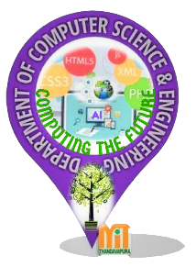
VILLAGE SIMULATION
MAHARAJA INSTITUTE OF TECHNOLOGY THANDAVAPURA
DEPARTMENT OF COMPUTER SCIENCE AND ENGINEERING
COMPUTER GRAPHICS LABORATORY MINI – PROJECT PRESENTATION
Presented by,
OSWIN S REGO [4MN17CS023]
HARSHITH N [4MN17CS015]
Under the guidance of
Prof. Bharath Bharadwaj B S,
Assistant Professor,
Department of CSE,
MITT, Mysore

Slide 2
Contents
Abstract
Introduction
Overview
Flowchart
UI design
Snapshots
Conclusion
Future Enhancement

Slide 3
Abstract
Computer Graphics is one of the ever emerging fields with the new inventions in the display technologies. Computer Graphics is an effective medium for communication between man and computer.
The main of this project is the pictorial view of village simulation using openGL. The features of the village stimulation revolve around showing the view of scenery of the village including all its attributes or the features.
The project involves the following features:
1) Helicopter.
2) Bullock cart.
3) Houses and the railway station.

Slide 4
The above features are supported by an easy to use keyboard interface.
There is the night vision of the village, which involves the helicopter the railway station and the some common features of the village such as the houses bullock cart etc.

Slide 5
Introduction
Computer Graphics become a powerful tool for the rapid and economical production of pictures. There is virtually no area in which Graphical displays cannot be used to some advantage so it is not surprising to find the use of CG so widespread.
Although early application in engineering & science had to rely on expensive & cumbersome equipment, advances in computer technology have made interactive computer graphics a practical tool. Computer Graphics is used in a diverse area such as science, engineering, medicine, business, industry, government, art, entertainment, education and training. Now it can be answered about computer graphics as generalized tool for drawing and creating pictures and simulates the real world situations within a small computer window
Aim of the project is the pictorial view of village stimulation using openGL. The features of the village stimulation revolve around showing the view of scenery of the village including all its attributes or the features.

Slide 6
Overview of the project
The project involves the following features:
1) Helicopter.
2) Bullock cart.
3) Houses and the railway station.
The above features are supported by an easy to use keyboard interface.
There is the night vision of the village, which involves the helicopter the railway station and the some common features of the village such as the houses bullock cart etc.

Slide 7
Outcome of the project
To draw the computer version of the simple ‘village stimulation’ and its role in daily life. It is the graphical representation of village stimulation and it’s working. The village stimulation show the real life graphical implementation of what happens in a common village, how people life moves around in the village.

Slide 8
Flowchart
START
DISPLAY FUNCTION:
glclear(GL_COLOR_BUFFER_BIT)
Display()
end

Slide 9
init FUNCTION:
START
glclearcolor(0.0,0.0,0.0,0.0)
glcolor3f(1.0,1.0,1.0)
glpointsize(4.0)
gluortho2D(0.0,1000.0,0.0,1000.0)
RETURN

Slide 10
start
Main display function():
moon
hill
cart
house
return

Slide 11
UI design
@ Algorithm :
Step 1: Start
Step 2: Initialize the attributes.
Step 3: Initialize the viewing window
Step 4: Initialize the display mode
Step 5: Initialize window size
Step 6: Initialize window position
Step 7: Display the village
:- create moon
:-create hill

Slide 12
Step 7:
:-create hill
:-create cart
:-create house
Step 8: go to step 3
:- add color
:-add size

Slide 13
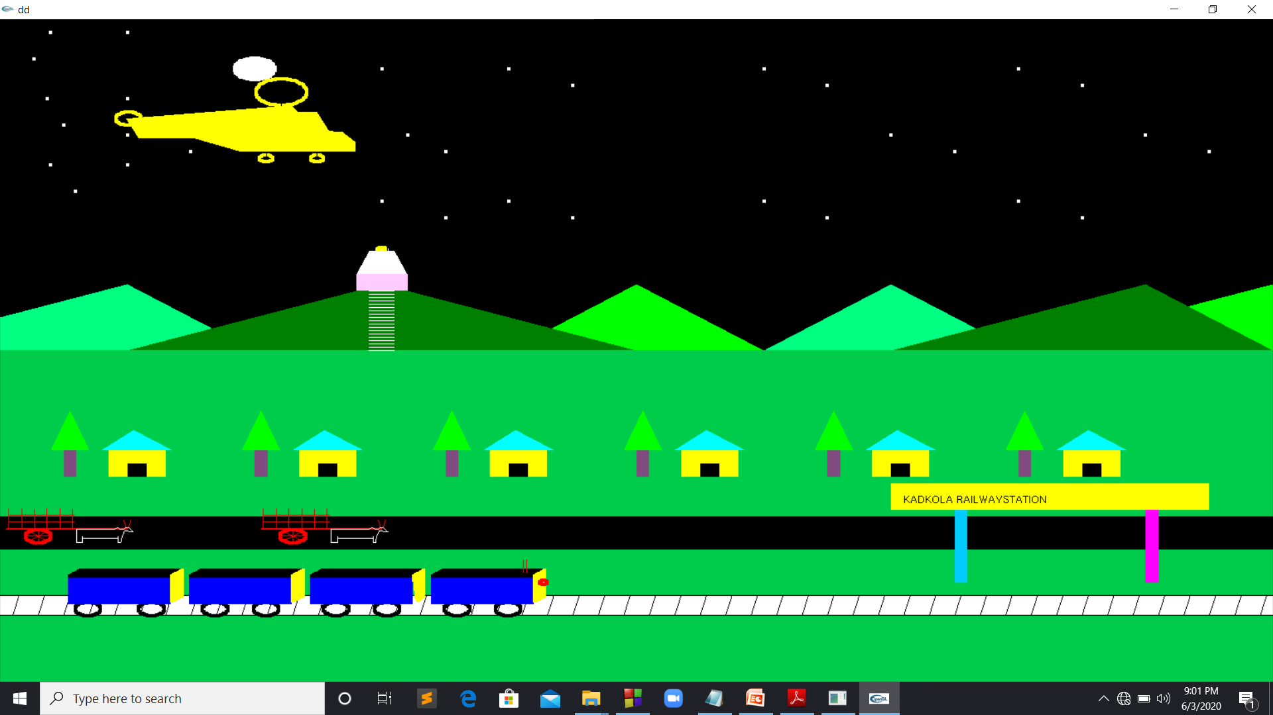
Snapshots: when the code runs

Slide 14
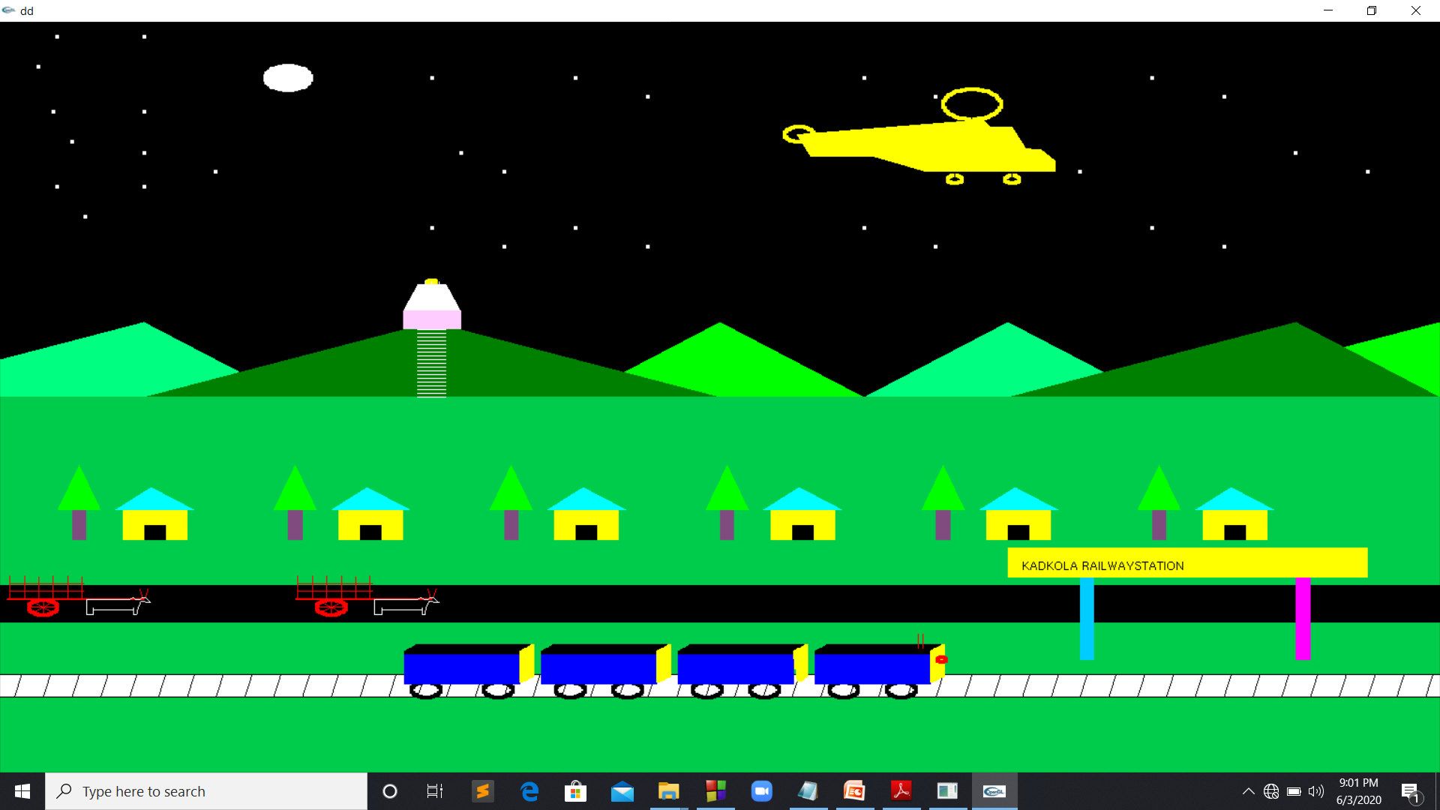

Slide 15
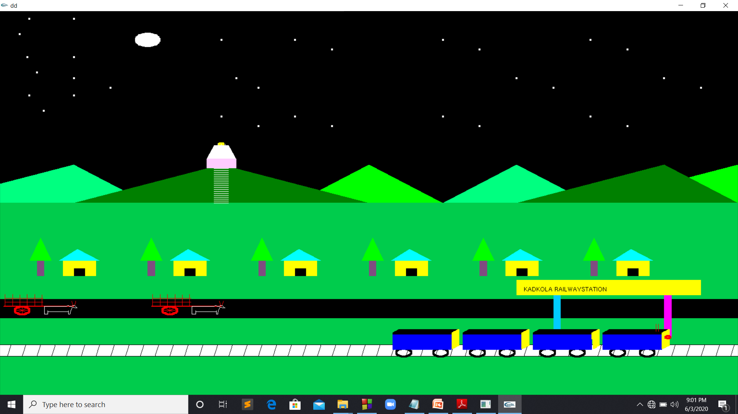
Last view of the project:

Slide 16
Conclusion
The village stimulation has been drawn and displayed in 2D objects by using the computer graphics, while showing how it’s works in general. It can be easily understood by the user. The demo is made more interactive with a keyboard and mouse interaction module in the program.
In this project, we tried to implement all the ideas and expectations to bring this project into reality. Although, we were limited by time period and our abilities to perform these ideas and make it real.

Slide 17
FUTURE ENHANCEMENT
Even though demo designed is enriched with many options, it is a two dimensional demo, in future it can be redesigned with 3D animation and sound effects. In future we can make a movement of a man, wind etc. . Along with this music can also be added. Making the user interface of this program simpler and more user friendly.

